Slide 1
The Wise Mission
Proverbs 11:30
Pastor Rod M. Lago

Slide 2
I. Our Mission is a continuation of JESUS Mission.

Slide 3
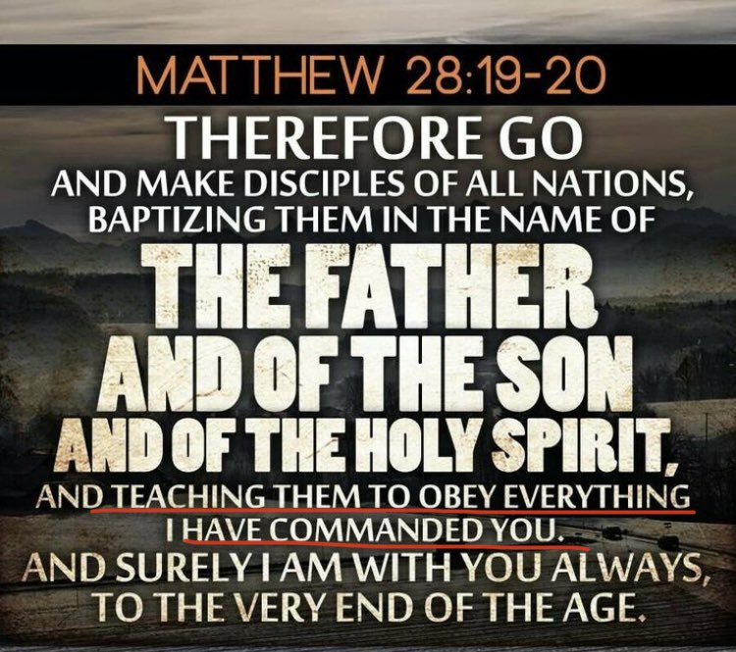

Slide 4


Slide 5
Life Application :
There must be an Increasing desire and Passion in our hearts to Obey it.
There must be a Christ centered mission motive to embrace it.
There must be an Undying Commitment.

Slide 6
II. Our Mission is a
WONDERFUL Privilege.

Slide 7
Life Application :
Don’t Waste it.
Share it to Others.
Embrace and Enjoy it.

Slide 8
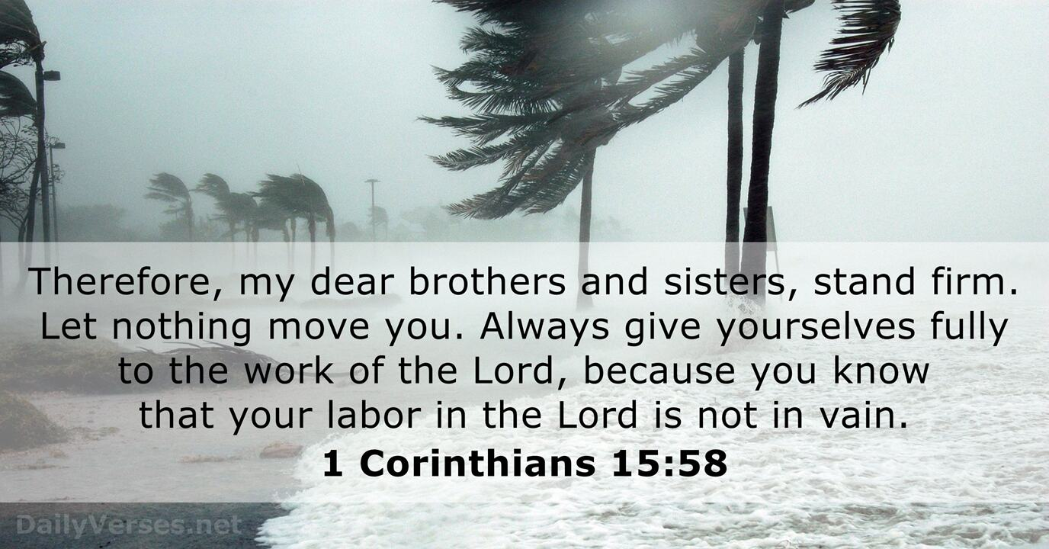

Slide 9
III. Our Mission has
ETERNAL SIGNIFICANCE.

Slide 10
Life Application :
Because it will IMPACT the eternal destiny of other People.
Because it will Prepare us for His RETURN.

Slide 11
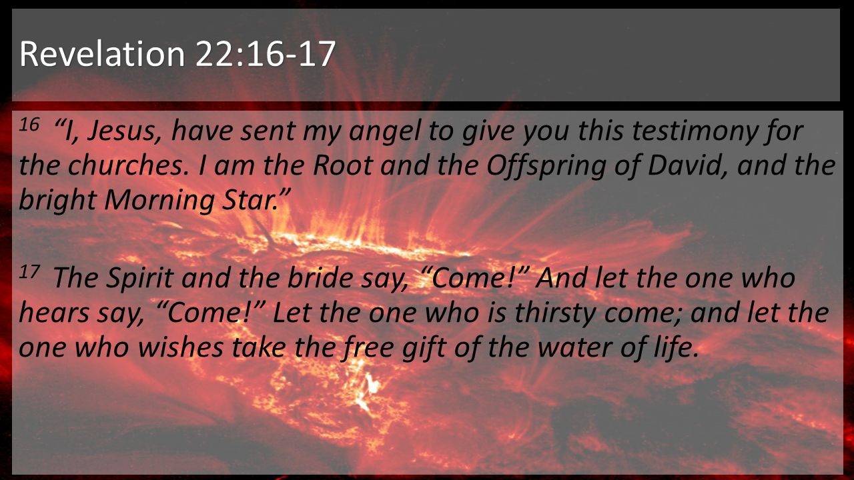

Slide 12
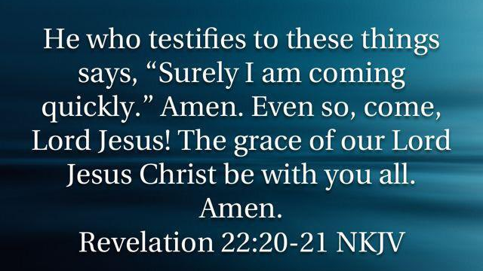

Slide 13
Conclusion :
WILLIAM JAMES said :
“The best use of Life is to spend it for something that Outlast it.”

